Slide 1
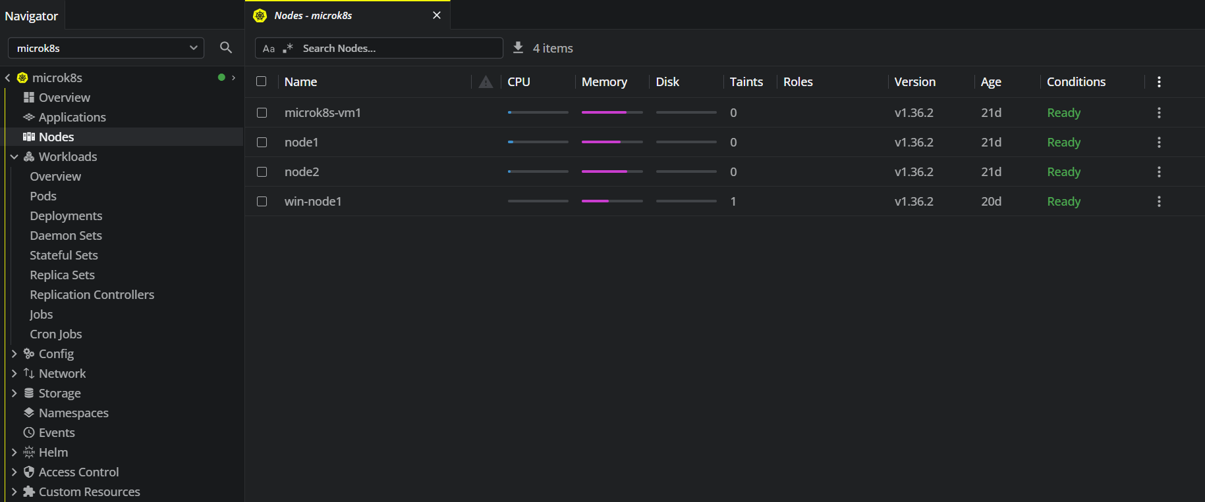
K8s nodes
3 linux nodes + 1 windows node
Nodes Health：Ready
K8s version：1.36.2

Slide 2
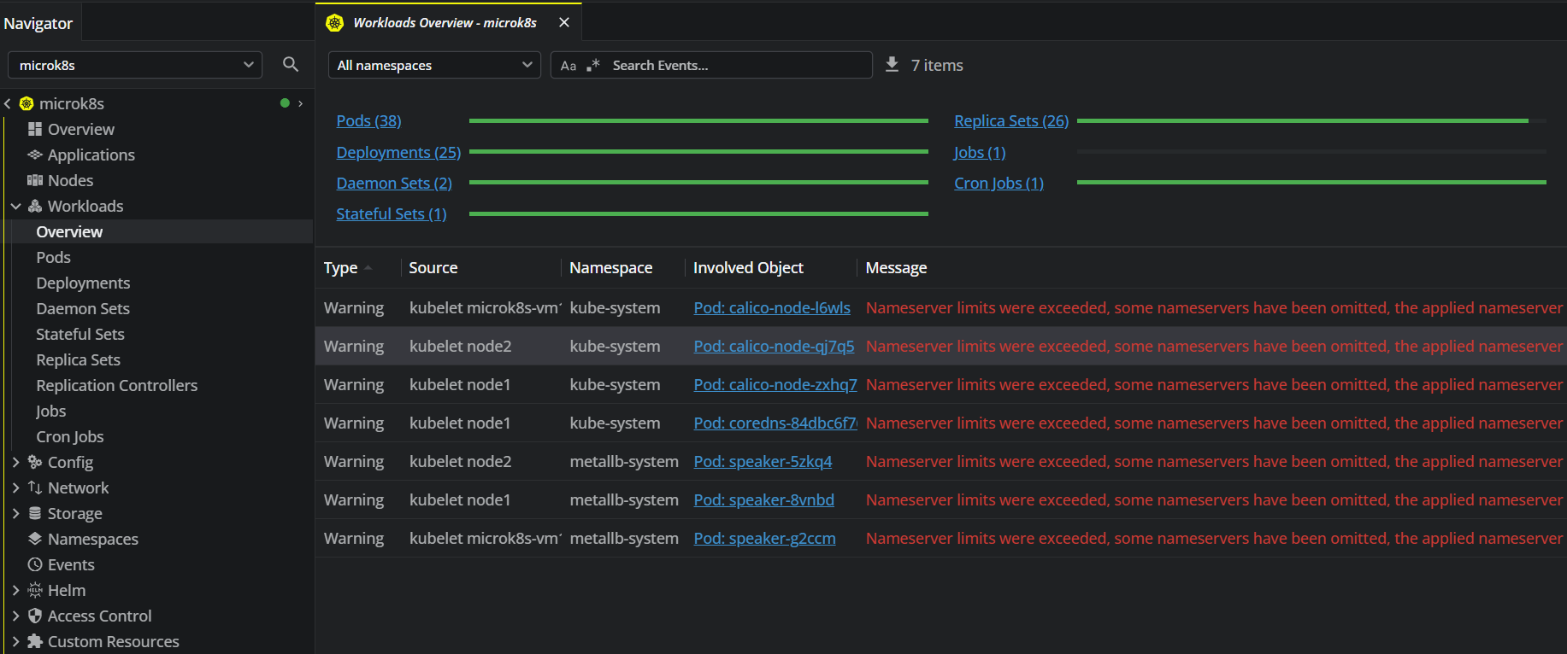
OverView－pods status check －Green(OK)

Slide 3
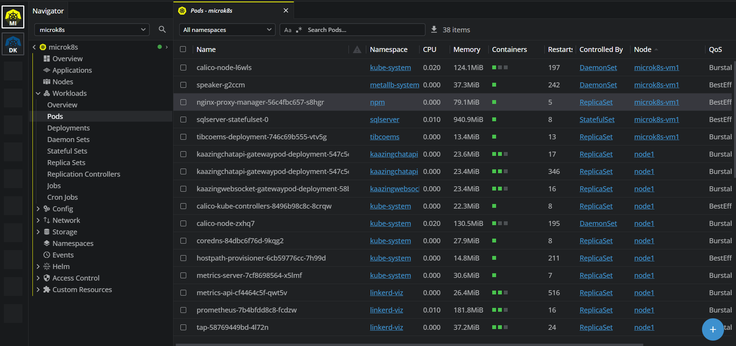
Pods List

Slide 4
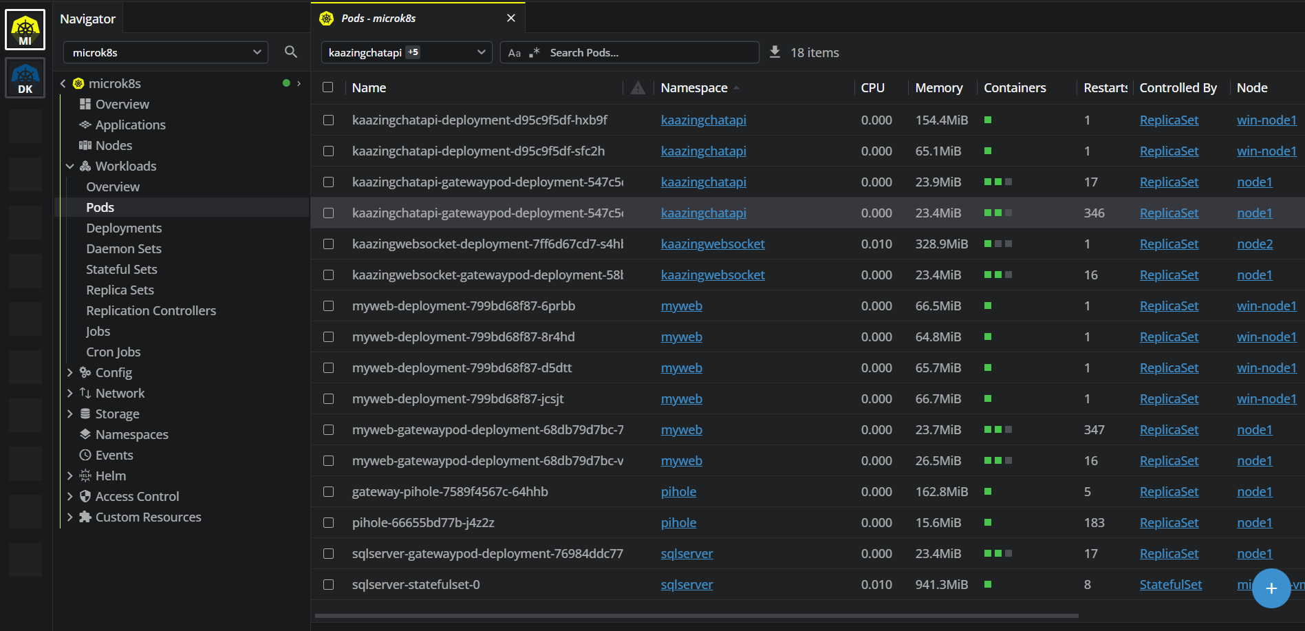
App Pods by Namespace(kaazingchatapi 、kaazingwebsocket 、 myweb、pihole 、sqlserver)

Slide 5
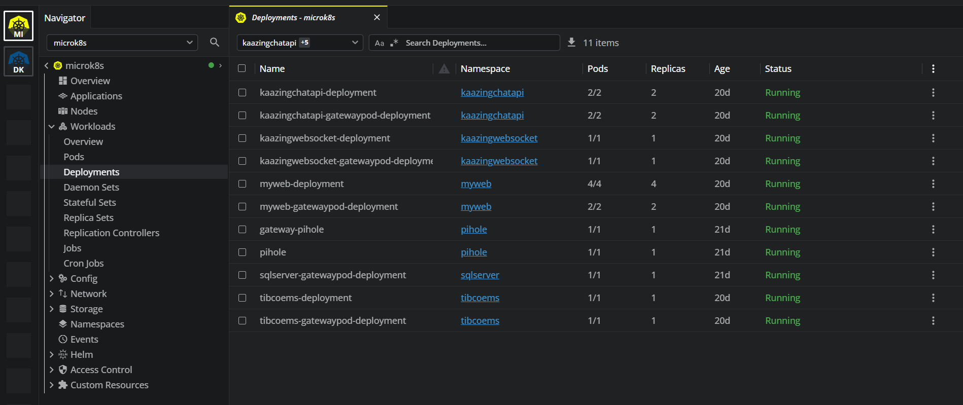
Deployments for app pods－kaazingchatapi、kaazingwebsocket 、myweb、pihole 、tibcoems

Slide 6
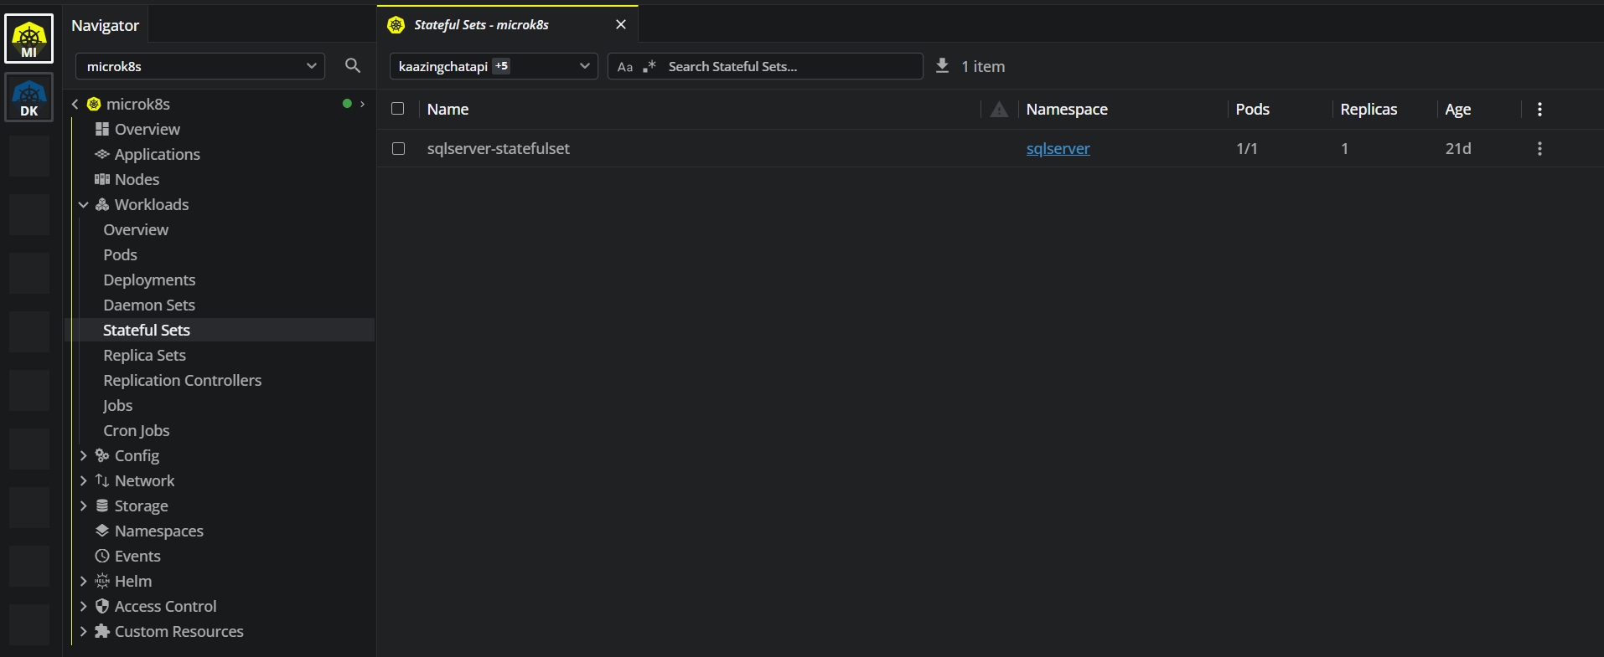
Stateful Sets for app pods－Sql server

Slide 7
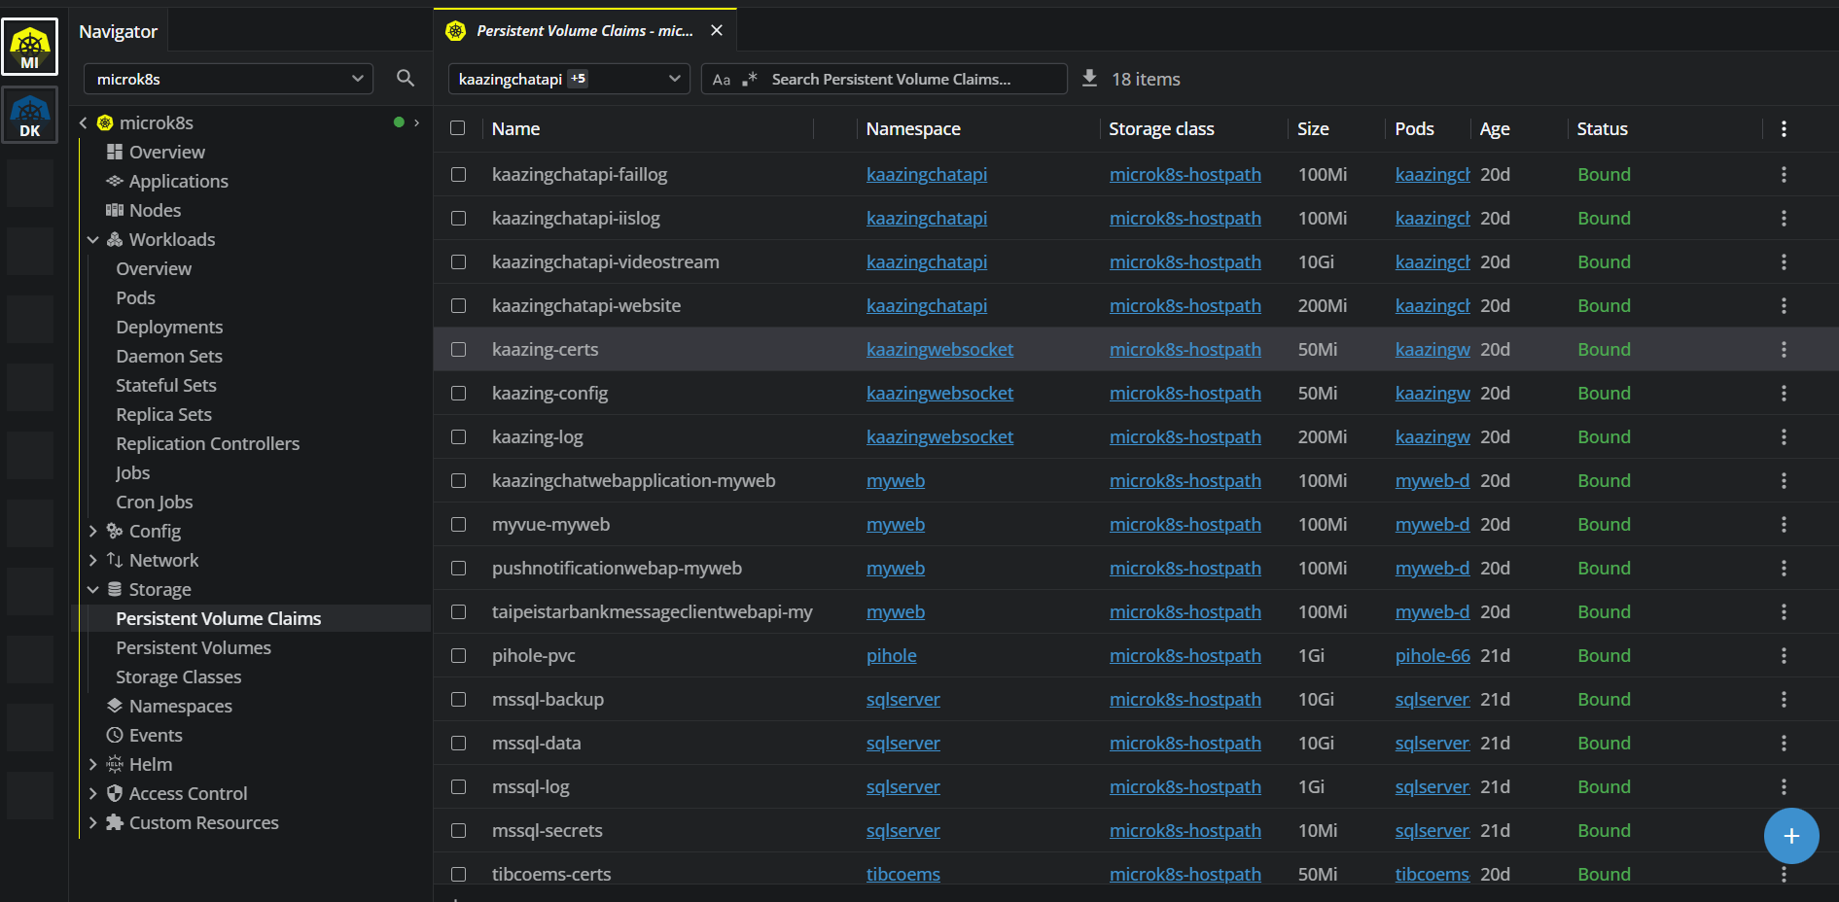
PVC

Slide 8
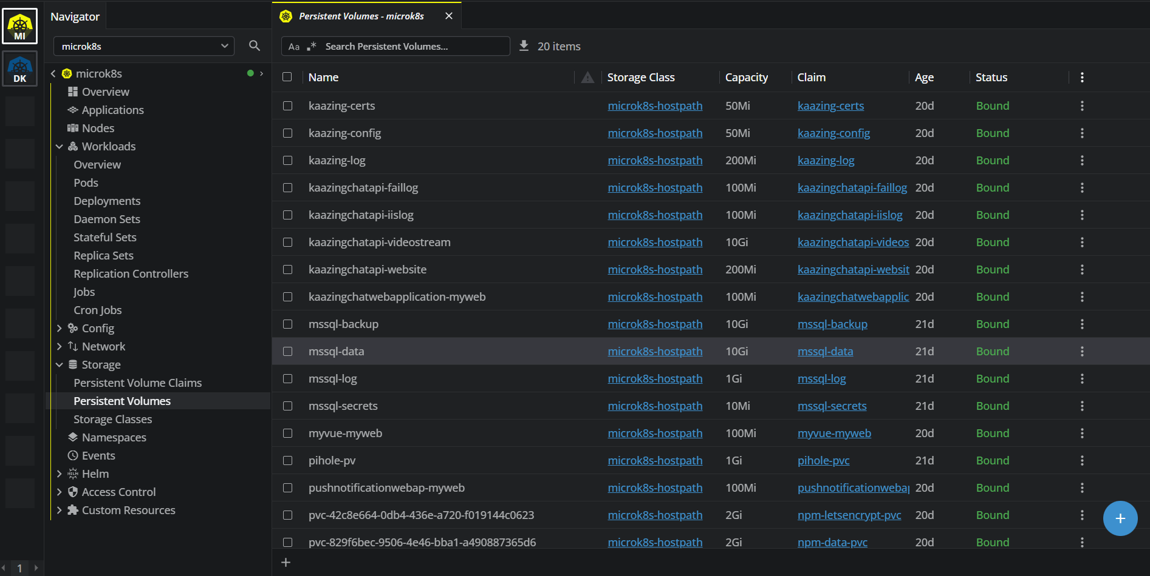
PV

